Slide 1

2024 Draft Operating Budget

Slide 2
Presentation Overview
Introduction
Operating Budget
Capital Impact
Sources of Revenue
Impact to the Average Property Owners
Additional Thoughts

Slide 3
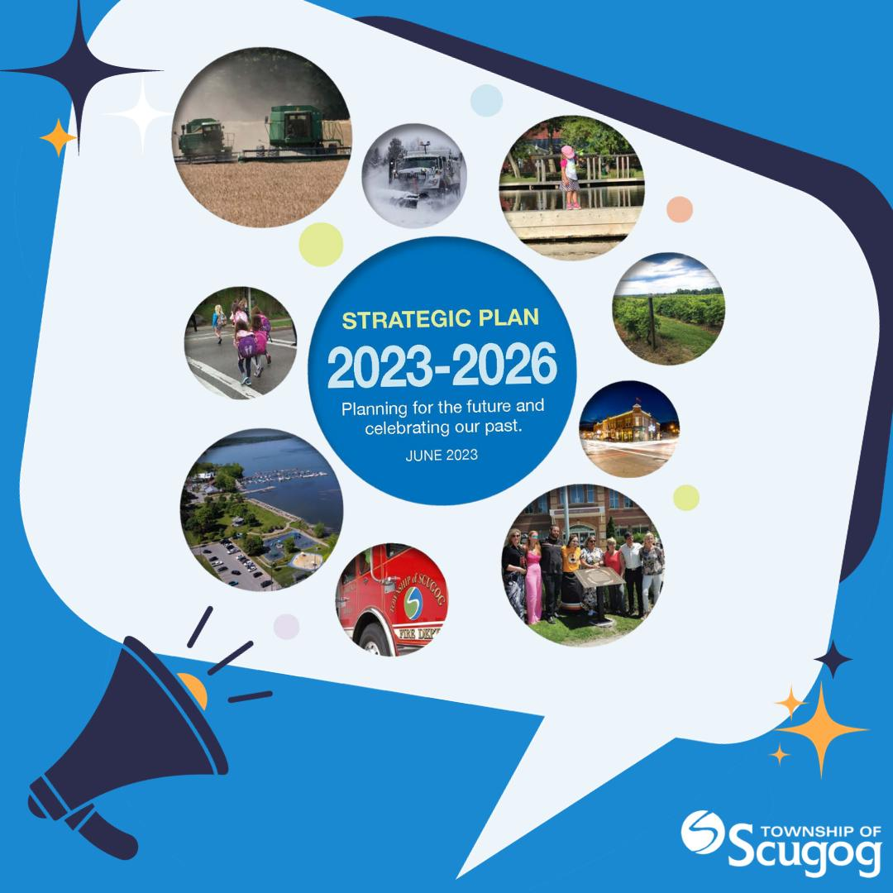

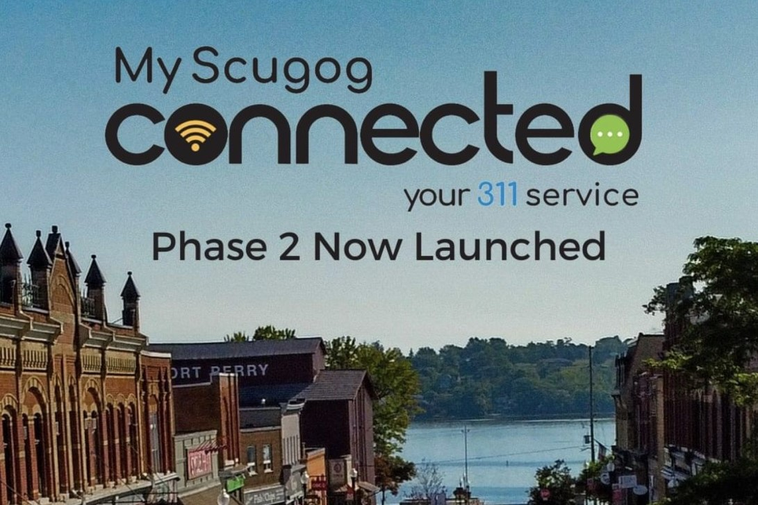

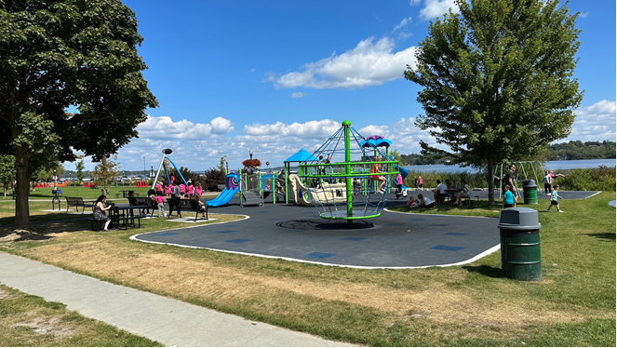
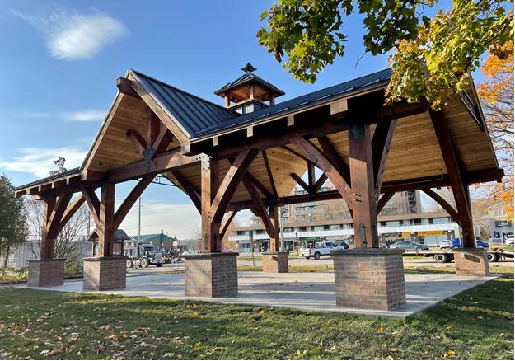
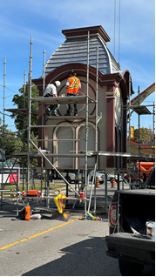
2023 Key Accomplishments
Finalization of Scugog Strategic Plan
Implementation of Virtual City Hall Software for Property Owners to access tax information
MyScugog Connected Phase 2
New Outdoor Skating Rink at Joe Fowler North Ball Diamond
New Playground at Palmer Park
New Picnic Shelter at Joe Fowler Memorial Park
Town Hall 1873 Bell Tower Restoration

Slide 4
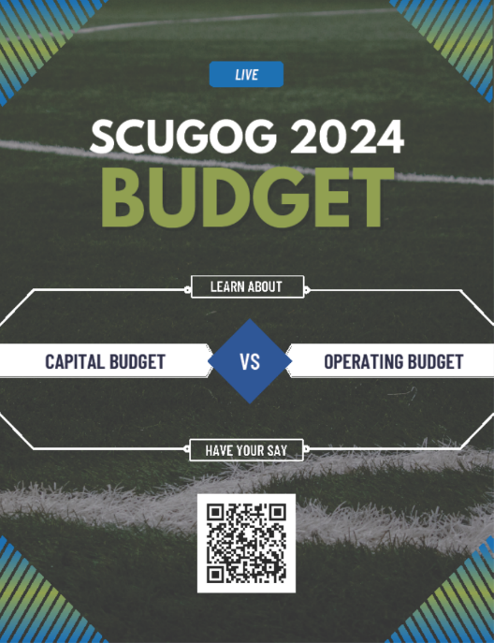


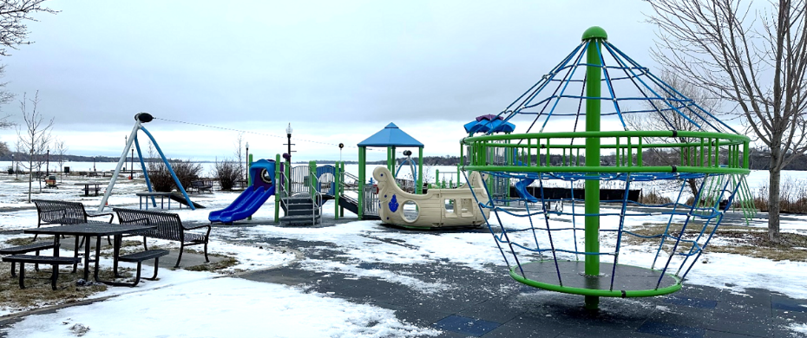


Community Engagement
Budget Survey
Draft Strategic Plan Consultation
Multi-Year Accessibility Plan
Parks Consultation
Service Level Review Survey
Website Design Survey with Focus Group

Slide 5
Operating Budget

Slide 6
Proposed 2024 Budget Increase
Increase in Budget to Maintain Service Levels
$715,510
Additional Costs related to Service Level Changes
$199,800
Additional Costs related to Growth / Other
$83,000
Increase in Assessment Growth & Increase in Supps
($288,350)
Increase in Transfer to Reserves to Fund Capital Program
$702,200
Overall Impact of
$1,412,160

Slide 7
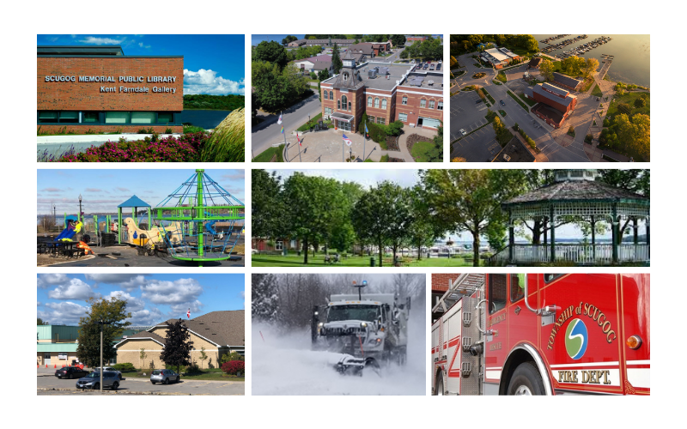
What Do You Get For Your Tax Dollars?

Slide 8
How Your Tax Dollar is Spent

Slide 9





2024 External Pressures
Labour Costs
$558,760
Mandatory Costs – Professional Fees
$116,500
Inflation – Materials & Supplies
$277,400
Inflation – Contracted Services
$167,700
Growth $

Slide 10
2024 DRAFT Operating Budget
Net Impact by Department
Department | 2023 Budget | 2024 Budget | Change
Mayor & Council | 347,600 | 369,400 | 21,800
Office of the CAO | 790,900 | 846,100 | 55,200
Corporate Services | 1,246,800 | 1,387,500 | 140,700
Finance | 216,700 | 68,500 | (148,200)
Fire & Emergency Services | 2,029,300 | 2,116,500 | 87,200
Public Works and Infrastructure Services | 8,913,200 | 9,930,510 | 1,017,310
Community Services | 2,268,600 | 2,531,300 | 262,700
Development Services | 1,039,900 | 1,252,000 | 212,100
Library | 738,500 | 790,200 | 51,700
Total Organization | 17,591,500 | 19,292,010 | 1,700,510
Change in PIL's, Supplmentary and Growth | (288,350)
1,412,160

Slide 11
Capital Impact on Operating Budget

Slide 12
Capital Budget Highlights
Based on the 2022 SOTI study, the road assets have a replacement cost of $546 million and a backlog of work totaling $166 million.
49 proposed projects for 2024; 21 new projects identified during budget process
Budget: $11,949,400

Slide 13



2024 Draft Operating Budget
Investment in Assets:
$526,640 increase for Roads
$87,780 increase for Vehicles &
Equipment
$87,780 increase for Building &
Facilities
Almost half of the 2024 increase of $1,412,160 relates to taking care of Township owned assets.

Slide 14
Roads and Other Infrastructure Annual Levies

Slide 15
Continuity of Capital Reserve Funds
 | Roads & Other Infrastructure | Vehicles & Equipment | Facilities & Building
Uncommitted Opening Balance | 1,389,500 | 809,670 | 960,500
2023 Capital Projects | (3,535,000) | (988,000) | (756,400)
Budget Allocation | 3,465,745 | 476,300 | 415,000
Other Contributions | 150,000 | 485,000 | 195,000
2023 Closing Balance | 1,470,245 | 782,970 | 814,100
2024 Capital Projects | (4,125,000) | (1,825,000) | (1,422,000)
Budget Allocation | 4,001,800 | 568,700 | 507,300
Other Contributions | 150,000 | 485,000 | 195,000
2024 Closing Balance | 1,497,045 | 11,670 | 94,400
2025 Capital Projects | (6,325,000) | (775,000) | (487,000)
Budget Allocation | 4,612,700 | 665,600 | 604,300
Other Contributions | 150,000 | 485,000 | 195,000
2025 Closing Balance | (65,255) | 387,270 | 406,700
2026 Capital Projects | (5,186,000) | (1,225,000) | (1,285,000)
Budget Allocation | 5,254,200 | 767,500 | 706,100
Other Contributions | 150,000 | 485,000 | 195,000
2026 Closing Balance | 152,945 | 414,770 | 22,800
2027 Capital Projects | (6,160,000) | (2,015,000) | (752,000)
Budget Allocation | 5,927,700 | 874,400 | 813,000
Other Contributions | 150,000 | 485,000 | 195,000
2027 Closing Balance | 70,645 | (240,830) | 278,800

Slide 16
Sources of Revenue

Slide 17
Property Tax Impact
An average Scugog Family pays 3% of their overall taxes to our lower tier municipality for property taxes

Slide 18
Where Does The Money Come From to Pay for Services

Slide 19
User Fees

Slide 20
Tax Burden by Property Class

Slide 21
Assessment Growth

Slide 22
Impact to the Average Property Owner

Slide 23
2024 Draft Operating Budget
Monthly Increase in Total Average Residential Tax Bill
 | 2023 | 2024 | $ Change | % On Total Property Tax Bill
Average CVA | $435,000 | $435,000 | $0.00 | 0.00%
Region of Durham | $234.00 | $251.55 | $1755 | 3.85%
Township of Scugog | $137.32 | $148.55 | $11.23 | 2.47%
Education | $55.46 | $55.46 | $0.00 | 0.00%
Total Tax | $426.78 | $455.56 | $28.78 | 6.32%

Slide 24
Value for Your Tax Dollars
Monthly Costs:
$4.73
Winter Maintenance
$1.46
Streetlighting
$4.21
Library
$4.34
Parks
$0.72
Crossing Guards

Slide 25
Additional Thoughts in Closing

Slide 26
Let’s Compare Based on Averages

Slide 27
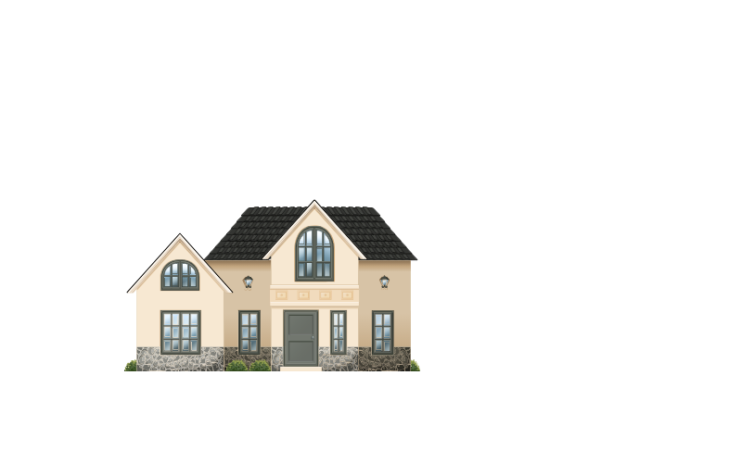
Let’s Compare Dollars for Local Services Based on Averages

Slide 28
Priorities for 2024
Continuing to Provide Value for Your Tax Dollars
Long Term Financial Planning
  Continue to invest in infrastructure through transfers to Capital Reserve Funds to fund AMP priorities based on 5-year forecast
Service Delivery and Organization Review Implementation
  Work to implement the highest priorities identified in the review.
Modernization
  Continue to implement new programs and processes that will modernize service delivery and advance the IT Strategic Plan.
Communication and Outreach

Slide 29
Ongoing Pressures
Inflation remains a significant concern
Interest rates
Impact of changes to legislation
Impact of Service Delivery and Organizational Review
Staffing capacity
Growth and the increase Demands for Service
Facility and Program capacity
Impact of environment and climate change
Ongoing maintenance of infrastructure assets
Reassessment cycle

Slide 30

Thank You
  This presentation will be available on our Township Website
  www.scugog.ca/budget
  Laura Barta, CPA, CMA
  Treasurer/Director of Finance
  lbarta@scugog.ca
  Sarah Durward, CPA, CA
  Manager of Finance/Deputy of Finance
  sdurward@scugog.ca

